Slide 1
PC Maintenance: Preparing for A+ Certification
Chapter 27: The Boot Process

Slide 2
Chapter 27 Objectives
Understand bootable disks
Identify key boot files in each OS version
List the boot sequence for each OS
Use alternative boot modes
Create and use a boot floppy
Use the Recovery Console
Create and use an ERD
Troubleshoot startup and shutdown problems

Slide 3
What Constitutes a Bootable Disk?
A disk that can bring the PC to a functional level, with the OS ready to accept user commands

Slide 4
Startup Configuration Files for DOS
CONFIG.SYS
  Used primarily under MS-DOS
  Plain text file
  Lists environment variables and device drivers
  Runs only at startup
AUTOEXEC.BAT
  Used primarily under MS-DOS
  Plain text file
  Lists applications to run at startup
  Simple batch file, can be rerun at any time

Slide 5
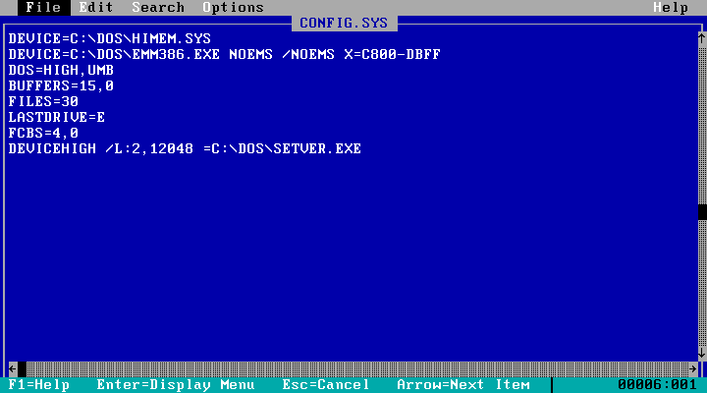
Sample CONFIG.SYS

Slide 6
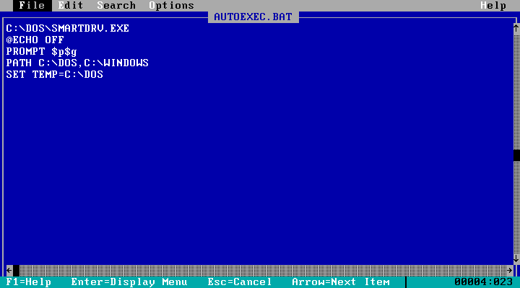
Sample AUTOEXEC.BAT

Slide 7
Startup Configuration Files for Windows 3.x
SYSTEM.INI
  Loads device drivers
  Defines environment variables
WIN.INI
  Loads applications
  Sets display settings and I/O device settings
  Defines application settings

Slide 8
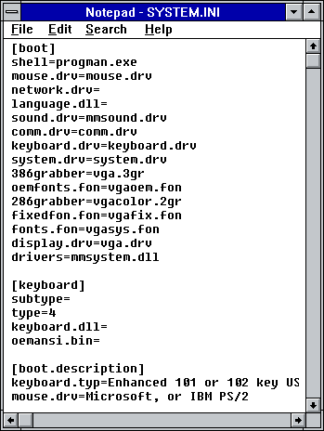
Sample SYSTEM.INI

Slide 9
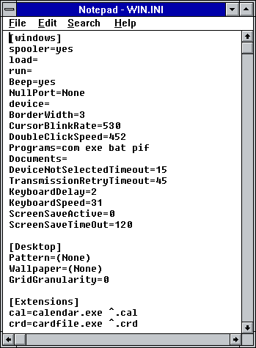
Sample WIN.INI

Slide 10
The Registry
32-bit versions of Windows system settings files
In Windows 9x: SYSTEM.DAT and USER.DAT
In Windows NT/2000/XP: SAM, SECURITY, SYSTEM, SOFTWARE, DEFAULT
Accessed through the Registry Editor as a single database

Slide 11
MS-DOS Boot Sequence
BIOS performs POST
BIOS searches for master boot record (MBR), which defines the active partition
MBR takes control and locates IO.SYS
IO.SYS takes control, identifies hardware
IO.SYS runs CONFIG.SYS
MSDOS.SYS takes control, loads OS kernel into RAM
MSDOS.SYS runs AUTOEXEC.BAT
Command.com displays a command prompt

Slide 12
Windows 9x Boot Sequence
BIOS performs POST
BIOS searches for MBR
MBR takes control and locates IO.SYS
IO.SYS takes control, runs MSDOS.SYS instructions
IO.SYS loads LOGO.SYS (graphic file) and displays it as Windows “splash screen”
IO.SYS looks for SYSTEM.DAT and USER.DAT and checks them

Slide 13
Windows 9x Boot Sequence
IO.SYS loads SYSTEM.DAT
IO.SYS executes CONFIG.SYS and AUTOEXECB.BAT if present
IO.SYS loads HIMEM.SYS
IO.SYS loads WIN.COM
Win.COM loads 386.VXD (virtual memory manager)
VMM386.VXD loads 32-bit device drivers

Slide 14
Windows 9x Boot Sequence
WIN.COM processes SYSTEM.INI if present
WIN.COM loads KRNL32.DLL, GDI.EXE, and USER.EXE
WIN.COM executes WIN.INI if present
WIN.COM runs any programs from Startup folder on Start menu

Slide 15
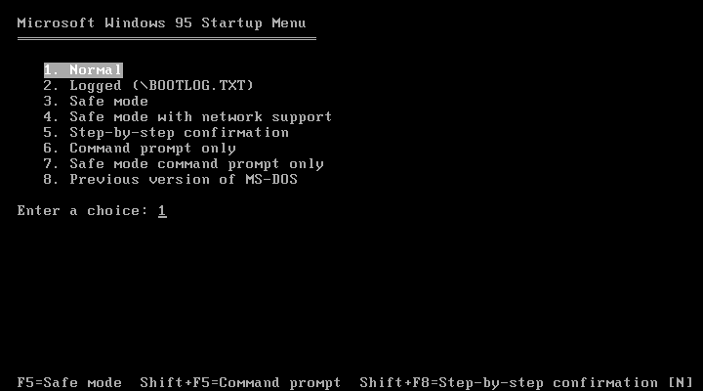
Alternative Boot Modes for Windows 9x
Press F8 as PC is starting up to see Startup Menu

Slide 16
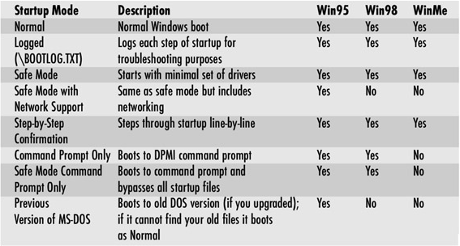
Alternative Boot Modes for Windows 9x

Slide 17
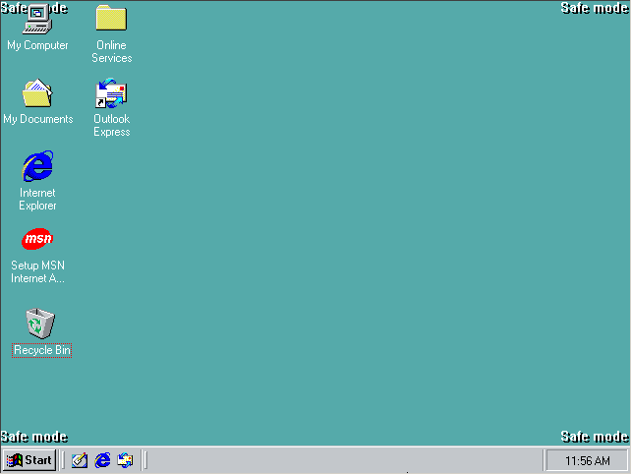
Safe Mode
Minimal set of drivers
Standard VGA driver
No support for CD, sound, modems

Slide 18
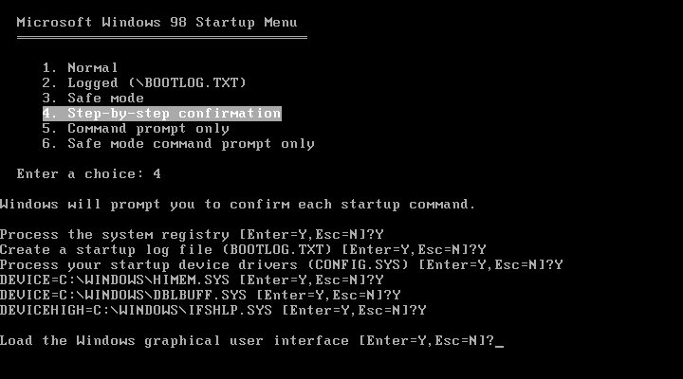
Step by Step Confirmation
Accept or reject each line of the startup

Slide 19
Windows NT, 2000, and XP Boot Sequence
BIOS performs POST
BIOS searches for MBR
MBR takes control and locates NTLDR
NTLDR switches CPU into 32-bit protected mode
NTLDR reads BOOT.INI. If multiple OSes, it displays a menu for user choice, and passes control to the chosen OS
NTLDR runs NTDETECT.COM, which detects the hardware for Registry

Slide 20
Windows NT, 2000, and XP Boot Sequence
NTLDR reads NTOSKRNL (OS kernel) into memory
NTLDR locates drivers for Registry-reported hardware
NTLDR hands over control to NTOSKRNL.EXE
NTOSKRNL.EXE loads the device drivers and the GUI

Slide 21
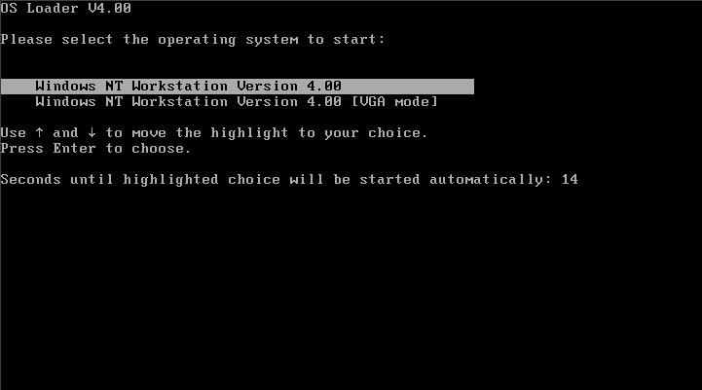
Alternative Boot Modes for NT 4
VGA mode

Slide 22
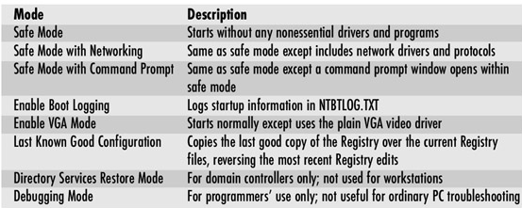
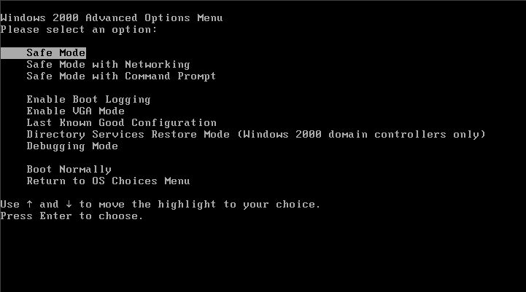
Alternative Boot Modes for Windows 2000 and XP

Slide 23
Troubleshooting 9x Startup
No operating system found
  No bootable disk is available
  PC does not see hard drive
  Hard drive not formatting
  No OS installed
  Loose connection to hard disk
  Physical malfunction
  Virus infection
  IO.SYS or MSDOS.SYS missing or corrupted

Slide 24
Troubleshooting 9x Startup
Error in CONFIG.SYS Line xx
  Driver called for in CONFIG.SYS missing or corrupted
Bad or Missing COMMAND.COM
Stuck at Windows splash screen
  Press Esc to see what is going on behind it
  Disable virtual memory
  Rebuild paging file

Slide 25
Troubleshooting 9x Startup
Missing, Corrupt, or Unloaded HIMEM.SYS
Windows protection error
  Virtual device driver problem
  Start in Safe Mode and check for a real-mode driver on CONFIG.SYS
  Remove and reinstall the device
Device referenced in SYSTEM.INI or WIN.INI not found

Slide 26
Troubleshooting 9x Startup
General protection fault (GPF)
  Two programs try to use the same memory space
  Make a note of the file causing the error, and restart
  If repeats, try reinstalling the associated program or using EXTRACT to re-copy file from Windows disc

Slide 27
Troubleshooting 2000/XP Startup
Try Safe Mode
Try restoring last known good configuration
If Windows XP, use System Restore
Repair Windows installation by booting from Setup CD and choosing Repair

Slide 28
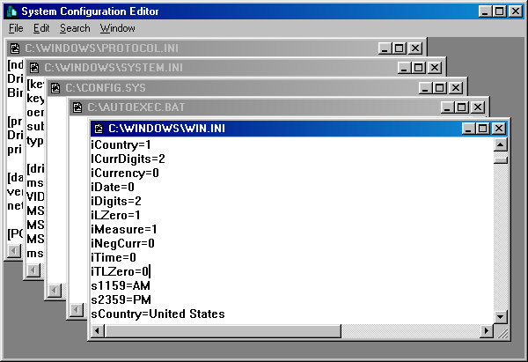
Controlling What Loads at Startup
Disable items in WIN.INI, SYSTEM.INI, AUTOEXEC.BAT, and CONFIG.SYS through the System Configuration Editor (SYSEDIT)

Slide 29
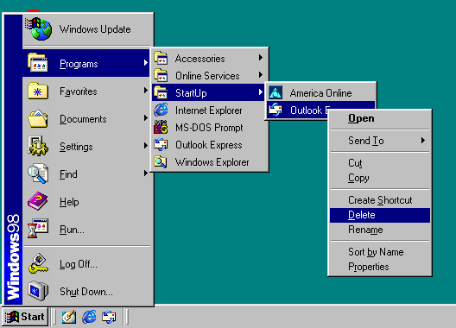
Controlling What Loads at Startup
Delete items from Startup folder on Start menu

Slide 30
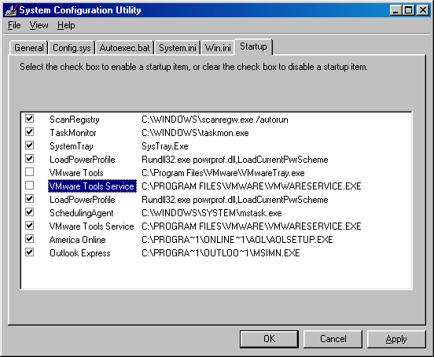
Controlling What Loads at Startup
Use System Configuration Utility (MSCONFIG) to disable startup items

Slide 31
Creating a 9x Startup Floppy
Open Control Panel
Add/Remove Programs, Startup Disk tab
Click Create Disk and follow the prompts

Slide 32
How a Boot Floppy Works
Booting from floppy creates RAM disk
Compressed files are decompressed onto RAM disk
Therefore… some utilities are directly on the floppy, and others are on the RAM disk

Slide 33
Files on a Boot Floppy
DRVSPACE.BIN: Support for hard disks compressed with DriveSpace
EBD.CAB: The compressed file containing extra utilities to be placed on RAM disk
AUTOEXEC.BAT and CONFIG.SYS
FINDRAMD.EXE: Locates the RAM disk
EXTRACT.EXE: Extracts compressed files to RAM disk
FDISK: Partitions disks
README.TXT: Information
CD-ROM drivers

Slide 34
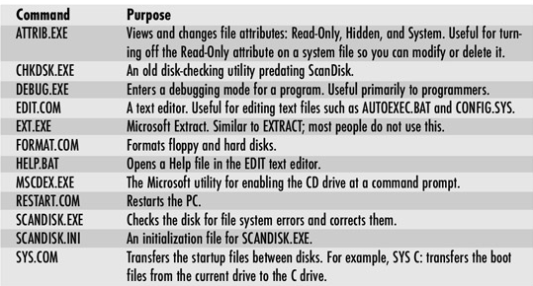
Files on the RAM Disk

Slide 35
What is an ERD?
Emergency Repair Disk
For Windows 2000/XP only
Not bootable
Stores settings that can help repair Windows, along with Windows Setup’s Repair mode
Specific to that PC

Slide 36
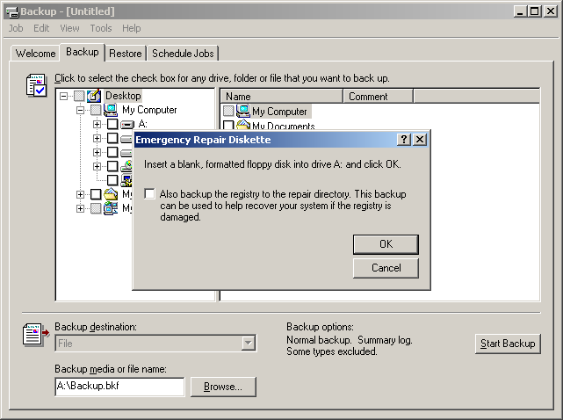
Creating an ERD
Start the Backup application
Click the Emergency Repair Disk button
Follow the prompts

Slide 37
What Is the Recovery Console?
Command-line interface
Limited set of commands
Accessible even when Windows will not start normally
Can repair the MBR, disable services, etc.

Slide 38
Booting to the Recovery Console
Boot from the Windows CD
Choose R for Repair
Choose C for Recovery Console
Type 1 to choose the Windows installation
Enter administrator password when prompted

Slide 39
Recovery Console Commands
Some are same as with Win9x startup disk:
  ATTRIB
  CD
  MD
  COPY
  DEL
  CHKDSK
  DIR
  EXIT
  EXPAND
  FORMAT
  MD
  RD
  REN

Slide 40
Recovery Console Commands
Some are different from normal command prompt commands:
  BATCH
  DISABLE
  DISKPART
  ENABLE
  FIXBOOT
  FIXMBR
  LISTSYS

Slide 41
Troubleshooting Shutdown Problems
Does not shut off with Shut Down command
  Is ACPI enabled in BIOS Setup?
  Is it an ATX motherboard?
  Is ACPI enabled in Windows?
  Are case wires connected to motherboard?
  Is a BIOS update available for motherboard?

Slide 42
Troubleshooting Shutdown Problems
Application Not Responding
  Click End Task if dialog box appears
  Press Ctrl+Alt+Delete and shut down application
No Shutdown with Power Button
  Hold power button down for 5 seconds

Slide 43
Troubleshooting Shutdown Problems
Windows 98 locks up when shutting down
  Download patch for Windows 98
  Disable Fast Shutdown (in MSCONFIG)

